Slide 1


Slide 2

HOW DEEP IS YOUR LOVE?
Self-acceptance
Past regrets
Reassembly

Slide 3





BASICS

Slide 4


TARGET AUDIENCE
Mid-core
25 – 35
Limited leisure
time
All genders
Implicit storytelling
Mental phenomena

Slide 5

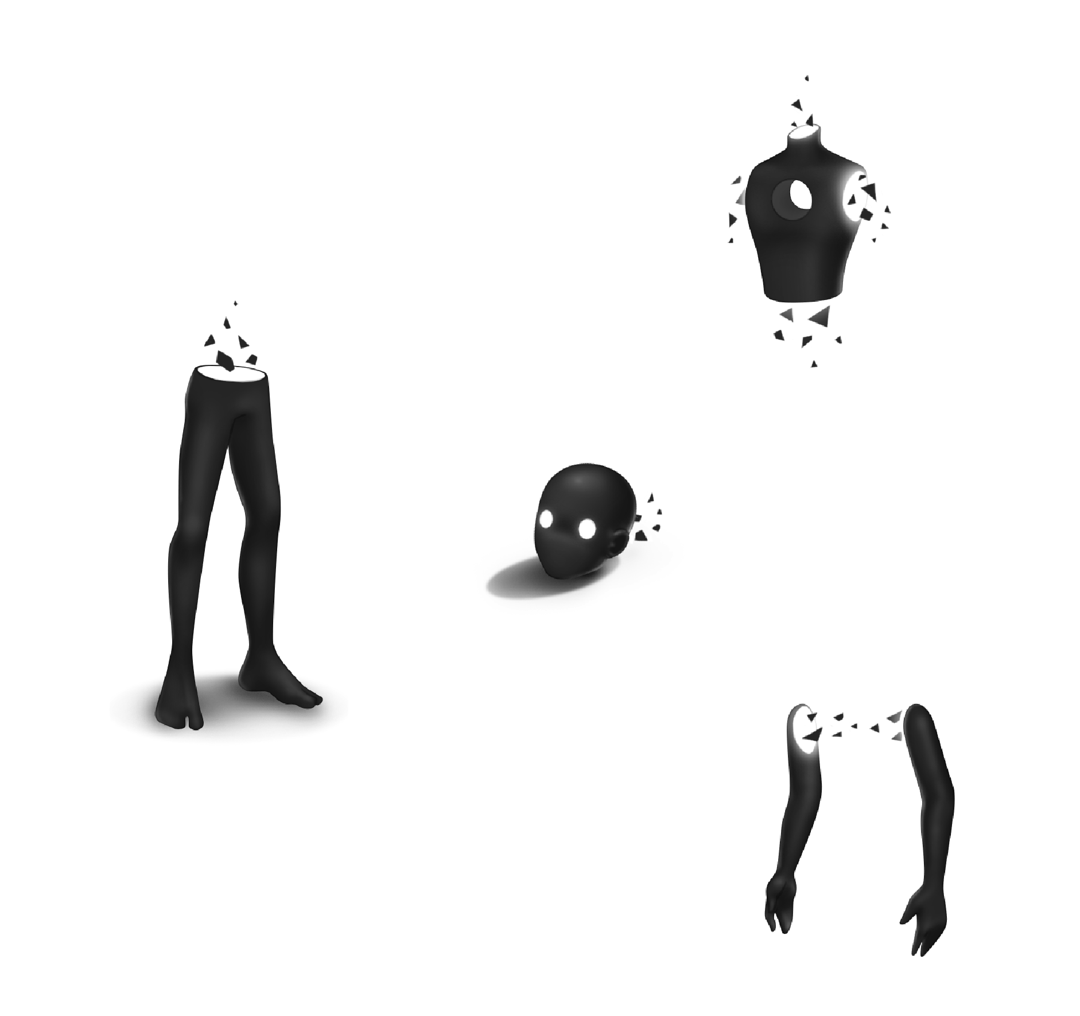
STRUCTURE

Slide 6

GAMEPLAY LOOP
Enter
Unlock
Analyze
Solve

Slide 7

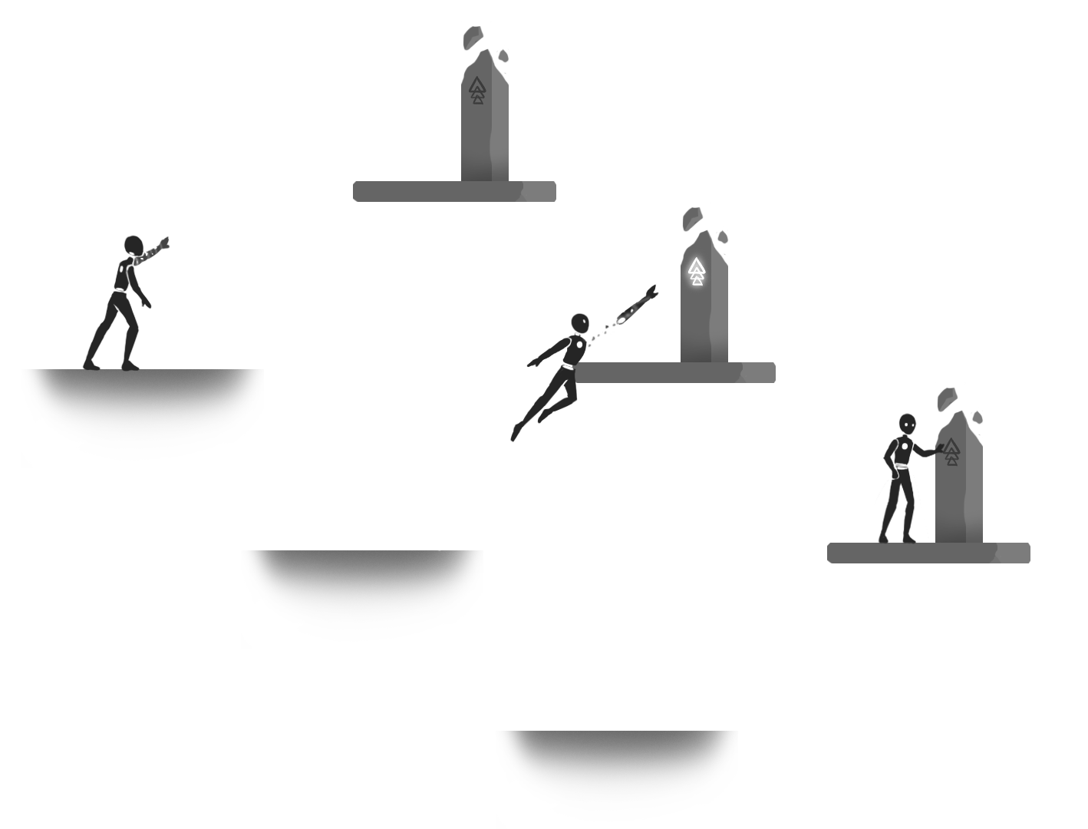
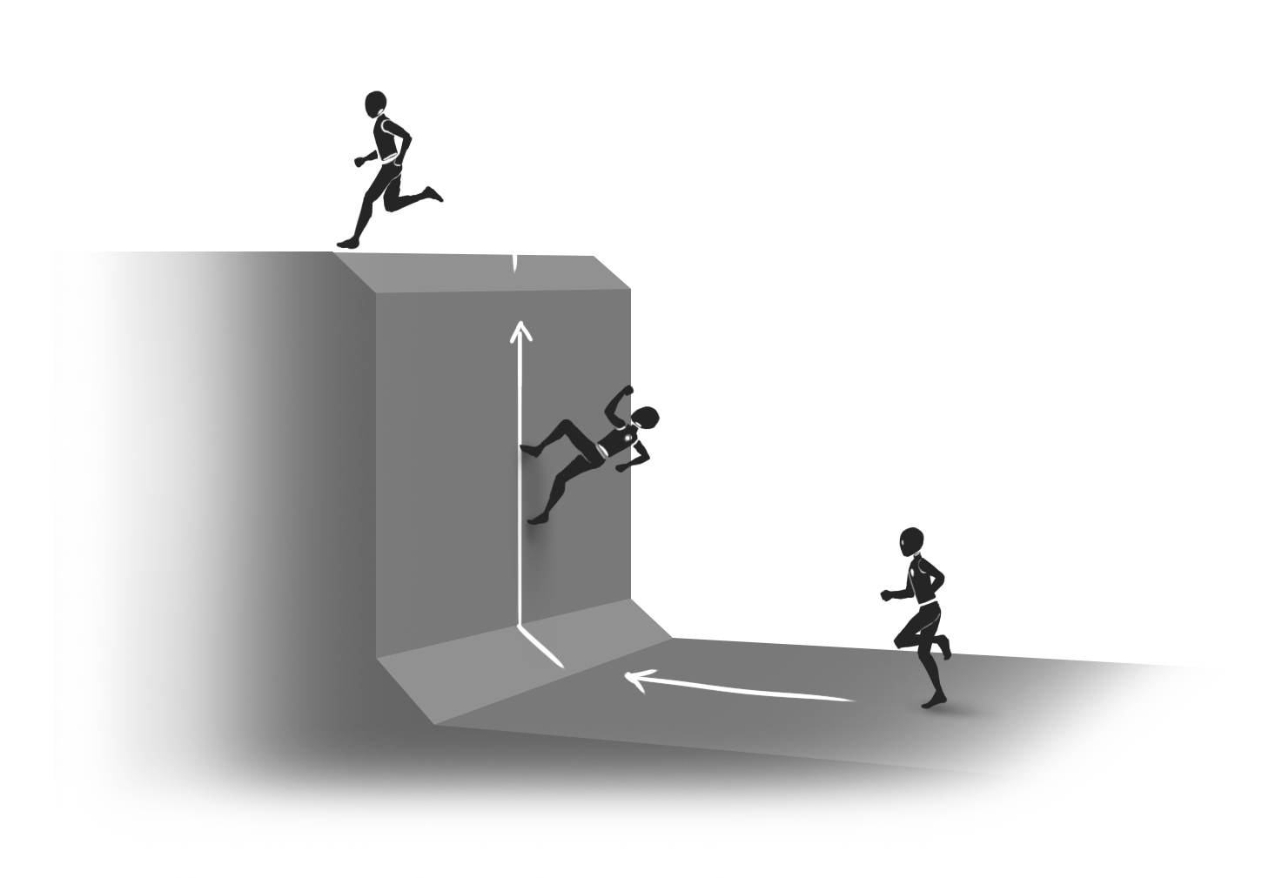
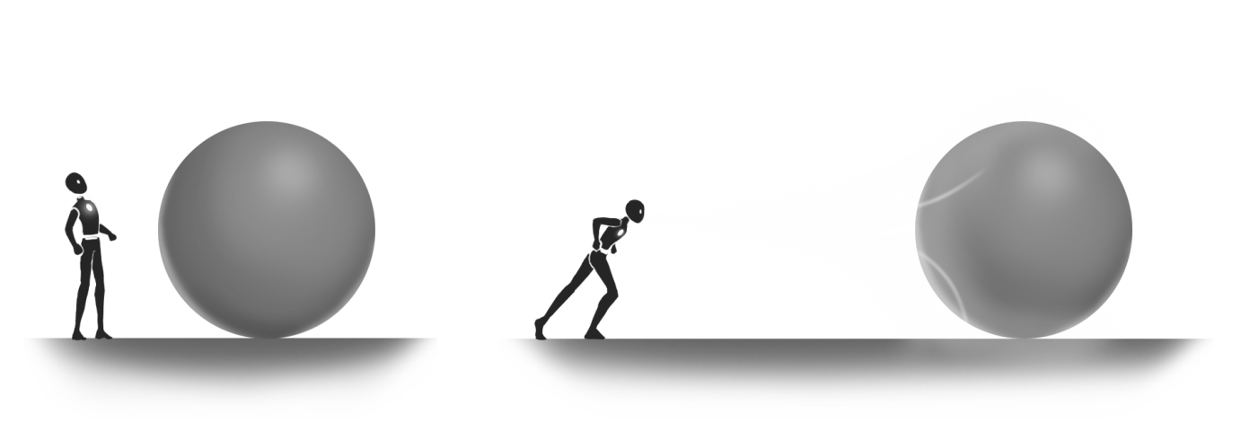
ABILITIES
Hook
Wall run
Breath

Slide 8
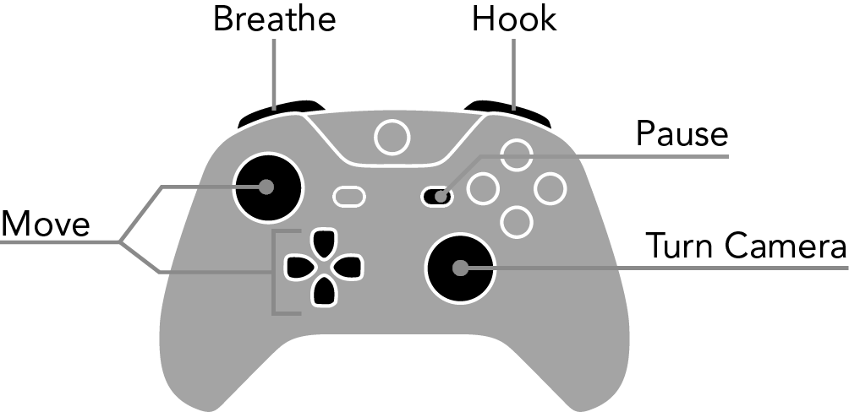
CONTROLS

Slide 9




NARRATIVE

Slide 10
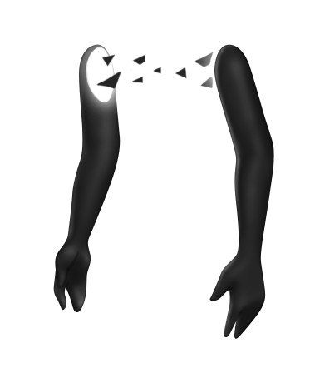
NARRATIVE
Aggression
Violence
Destruction

Slide 11
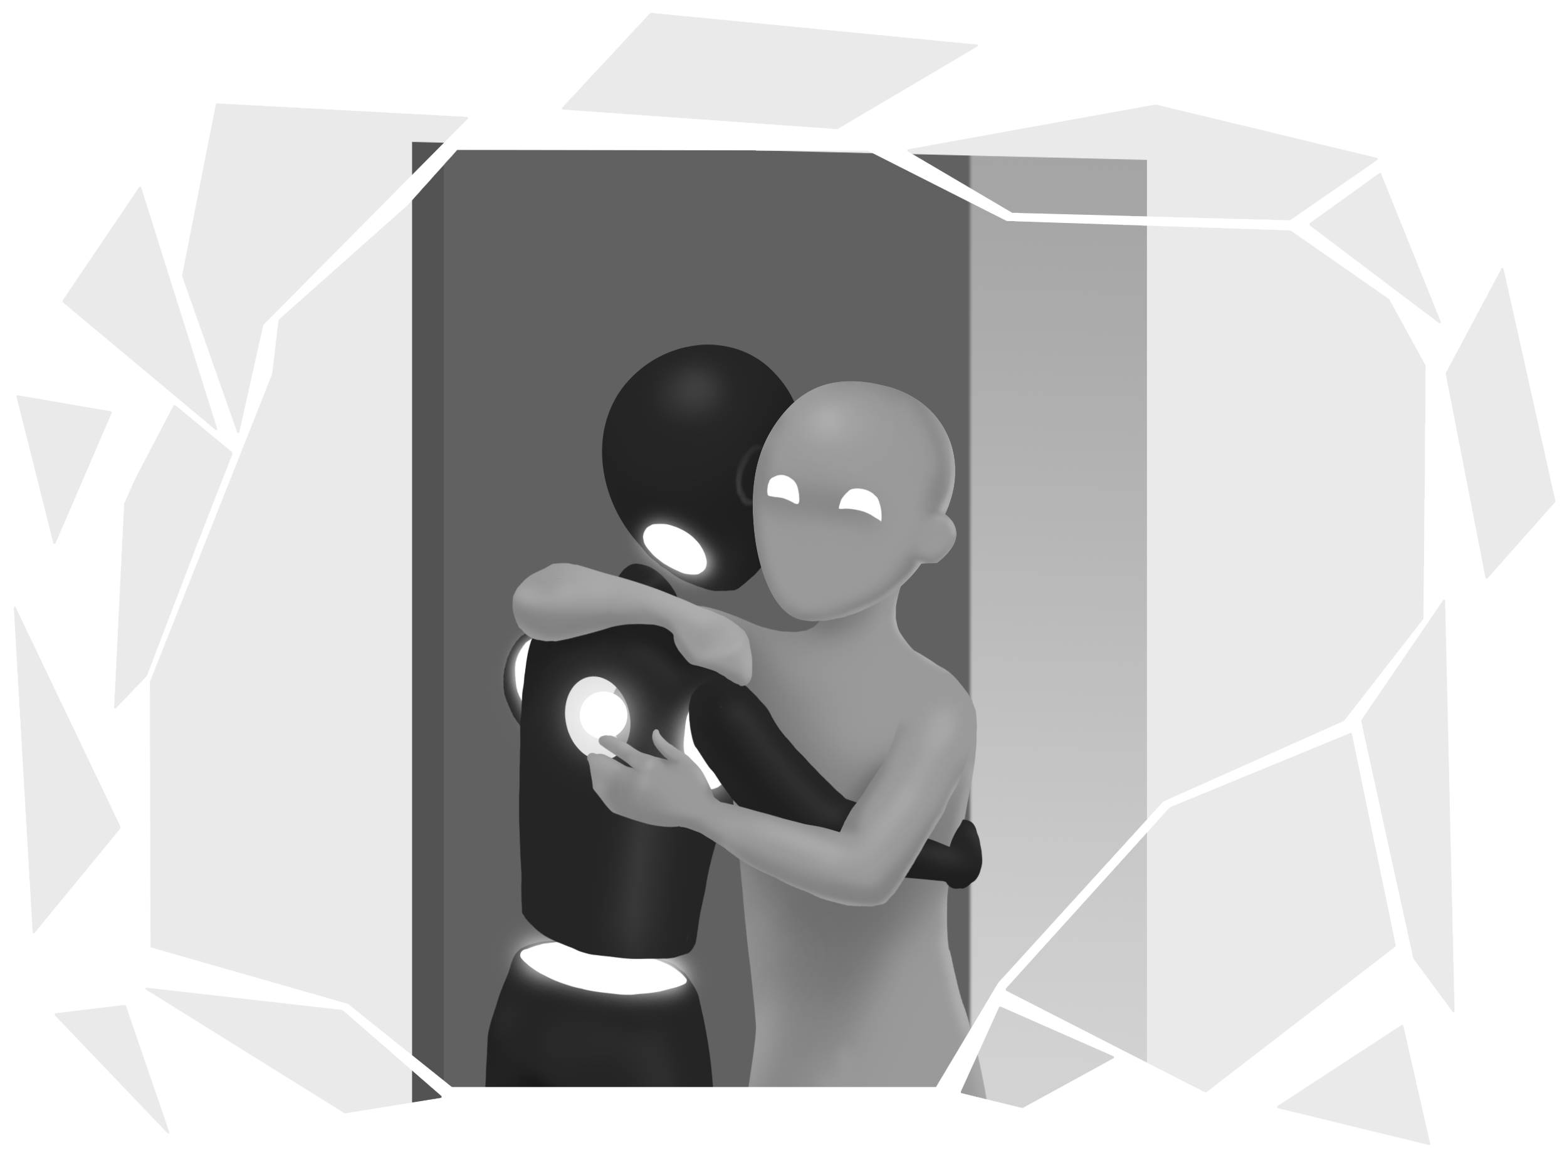

Slide 12
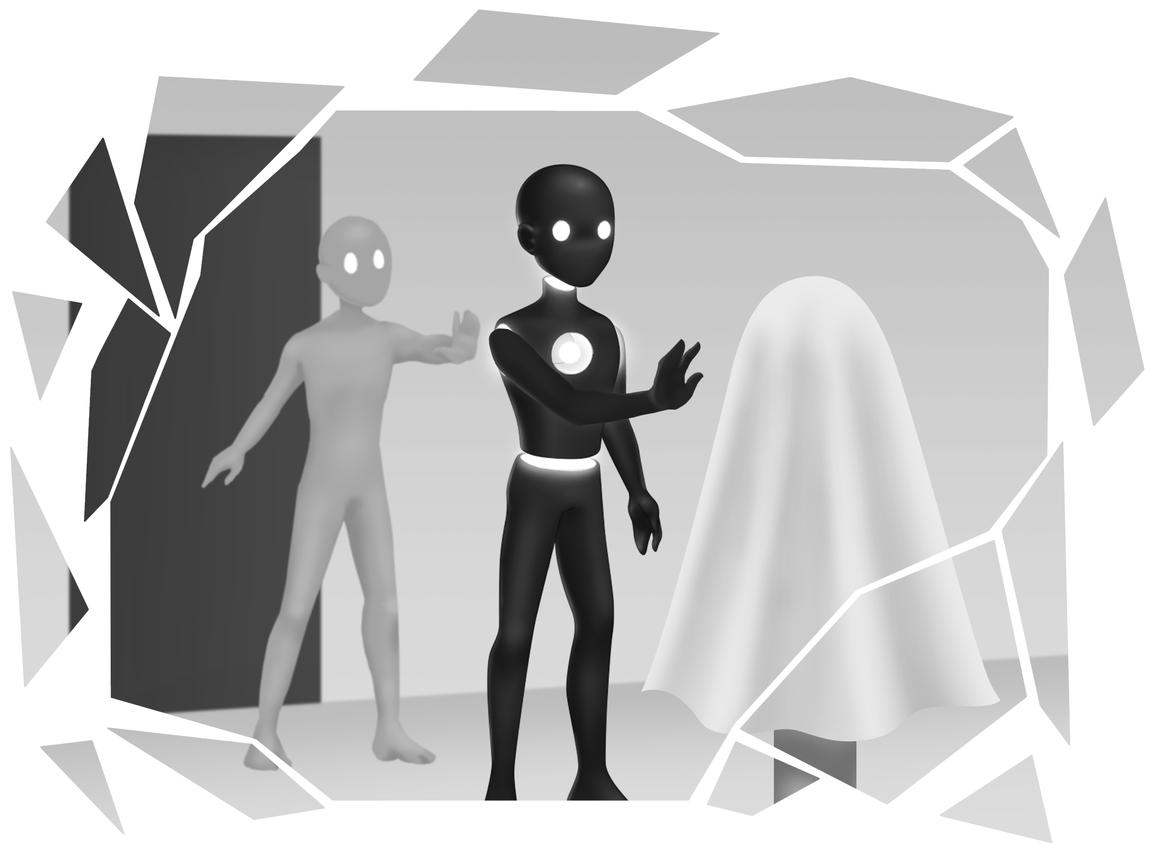

Slide 13


Slide 14
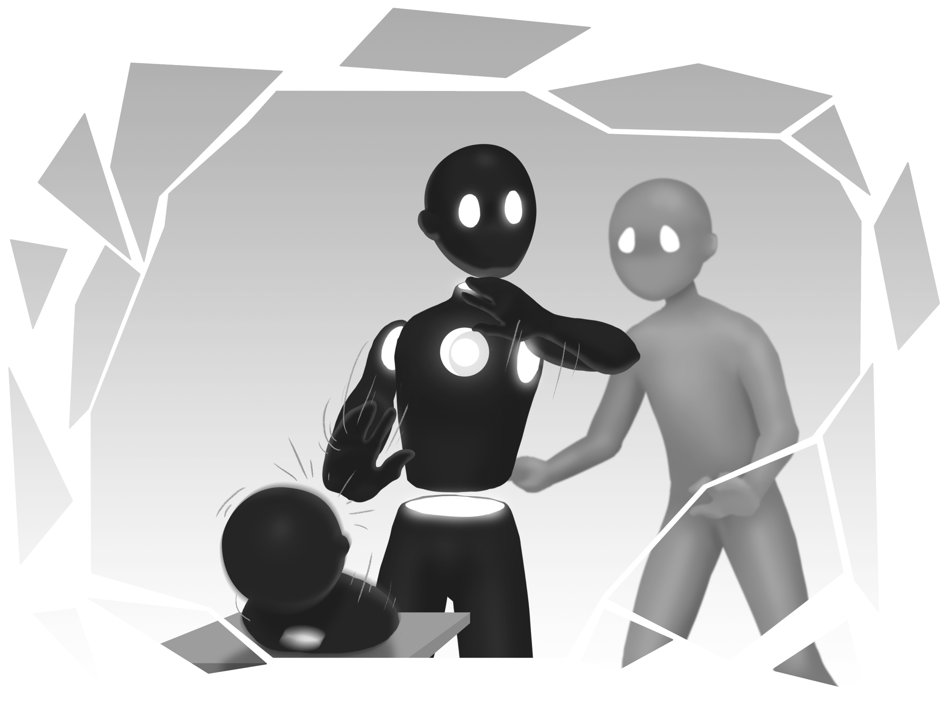

Slide 15
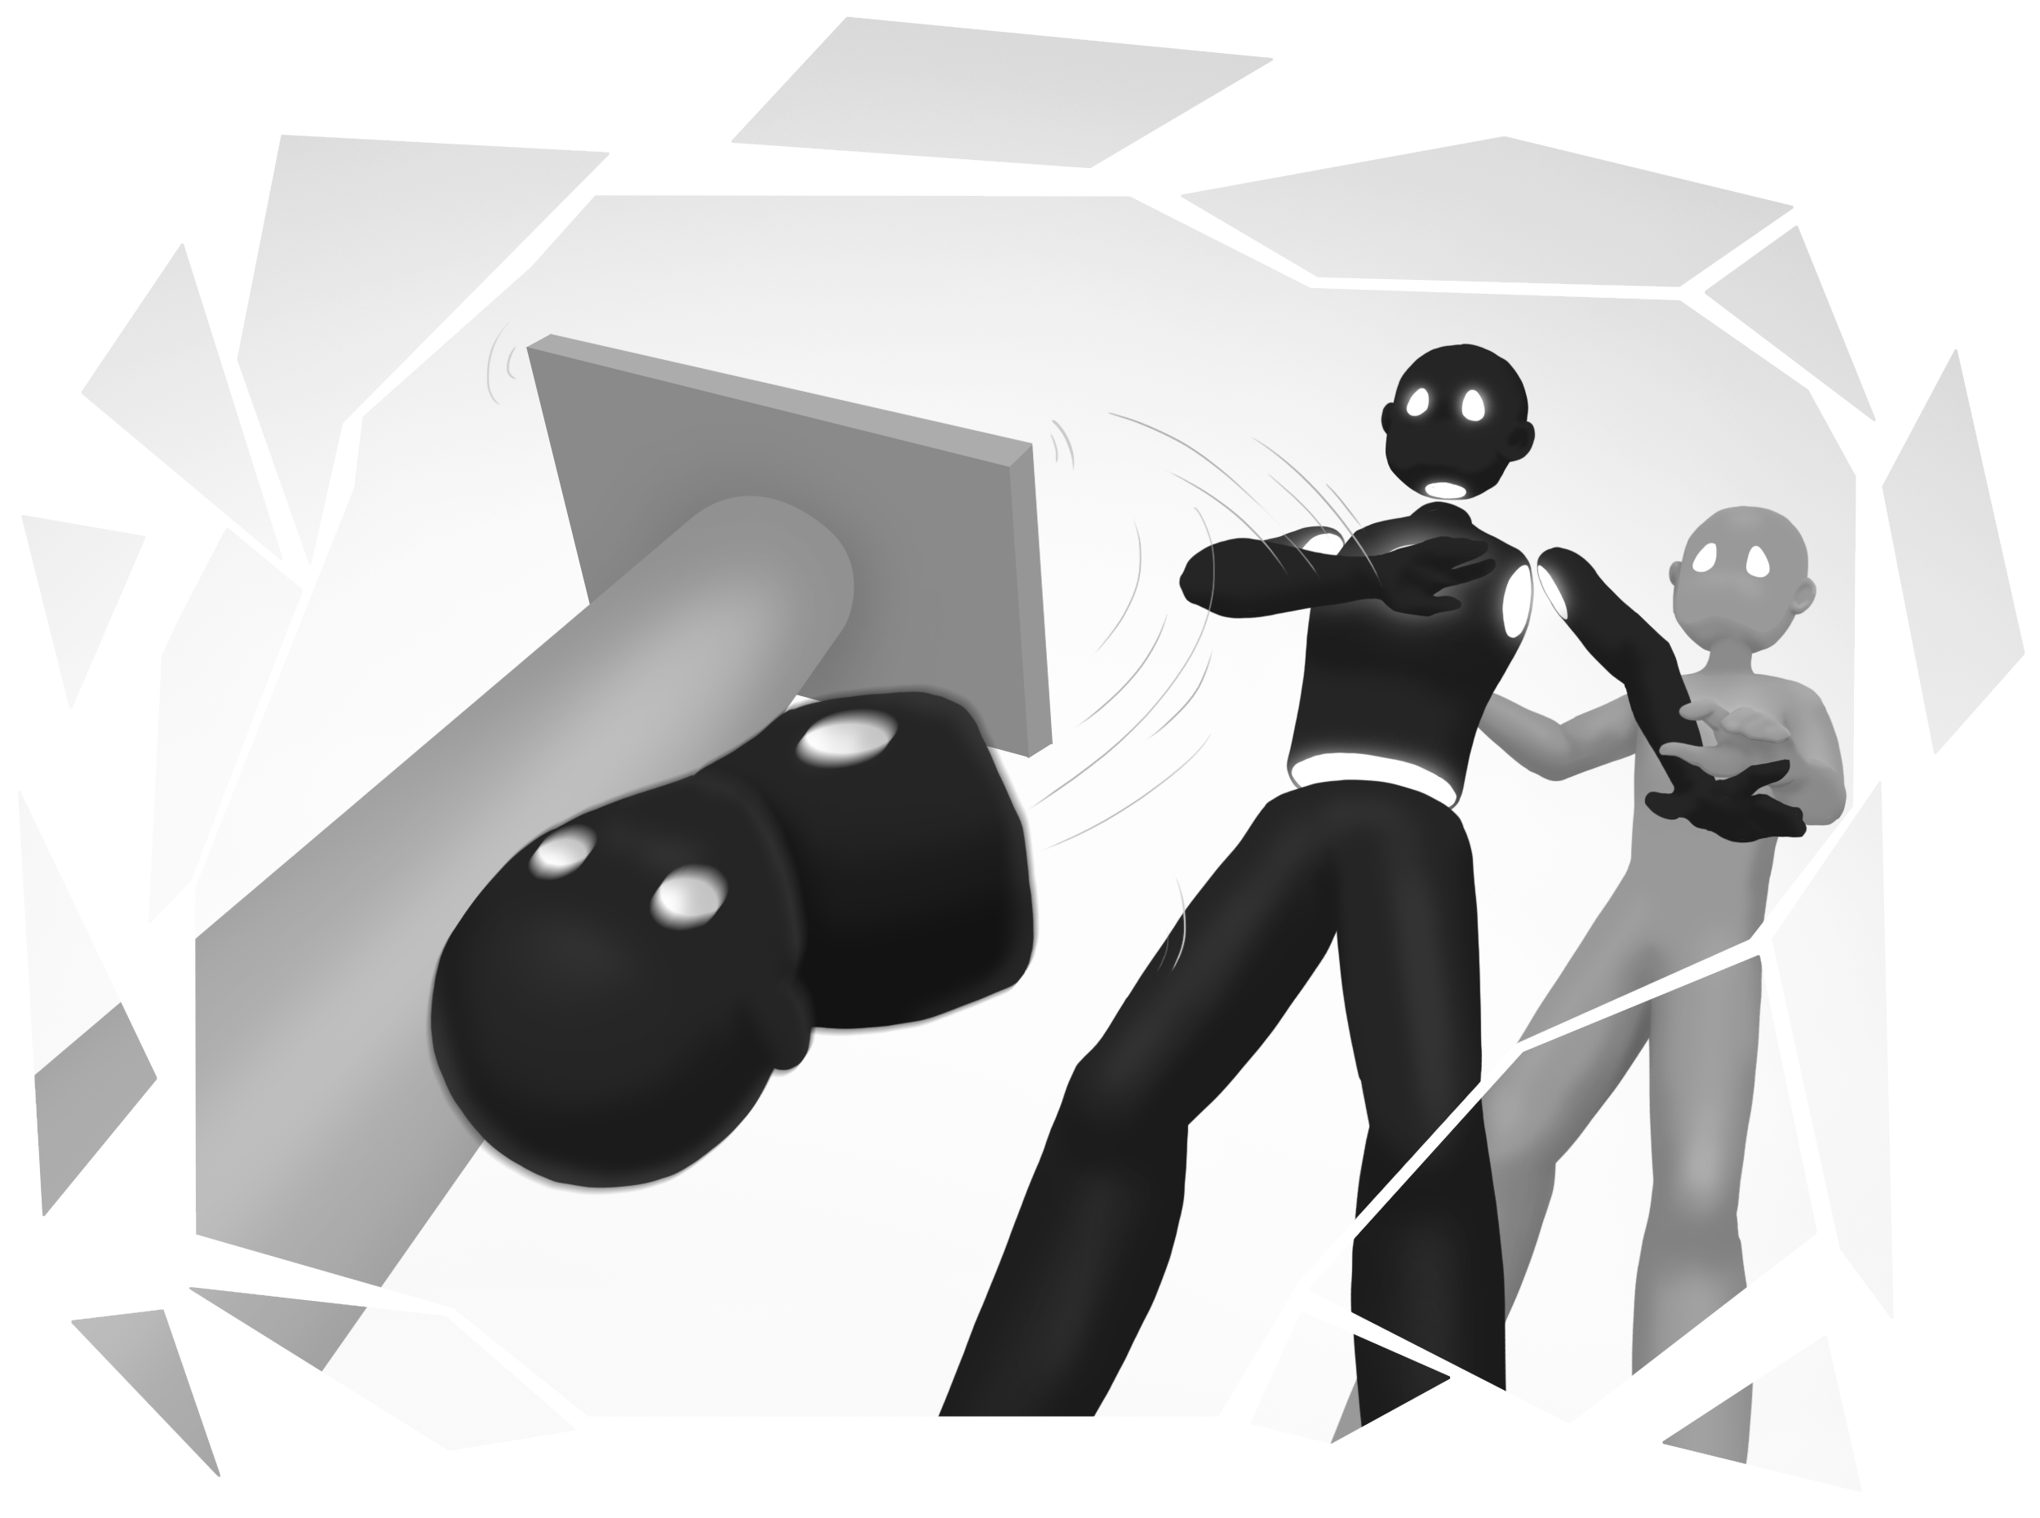

Slide 16
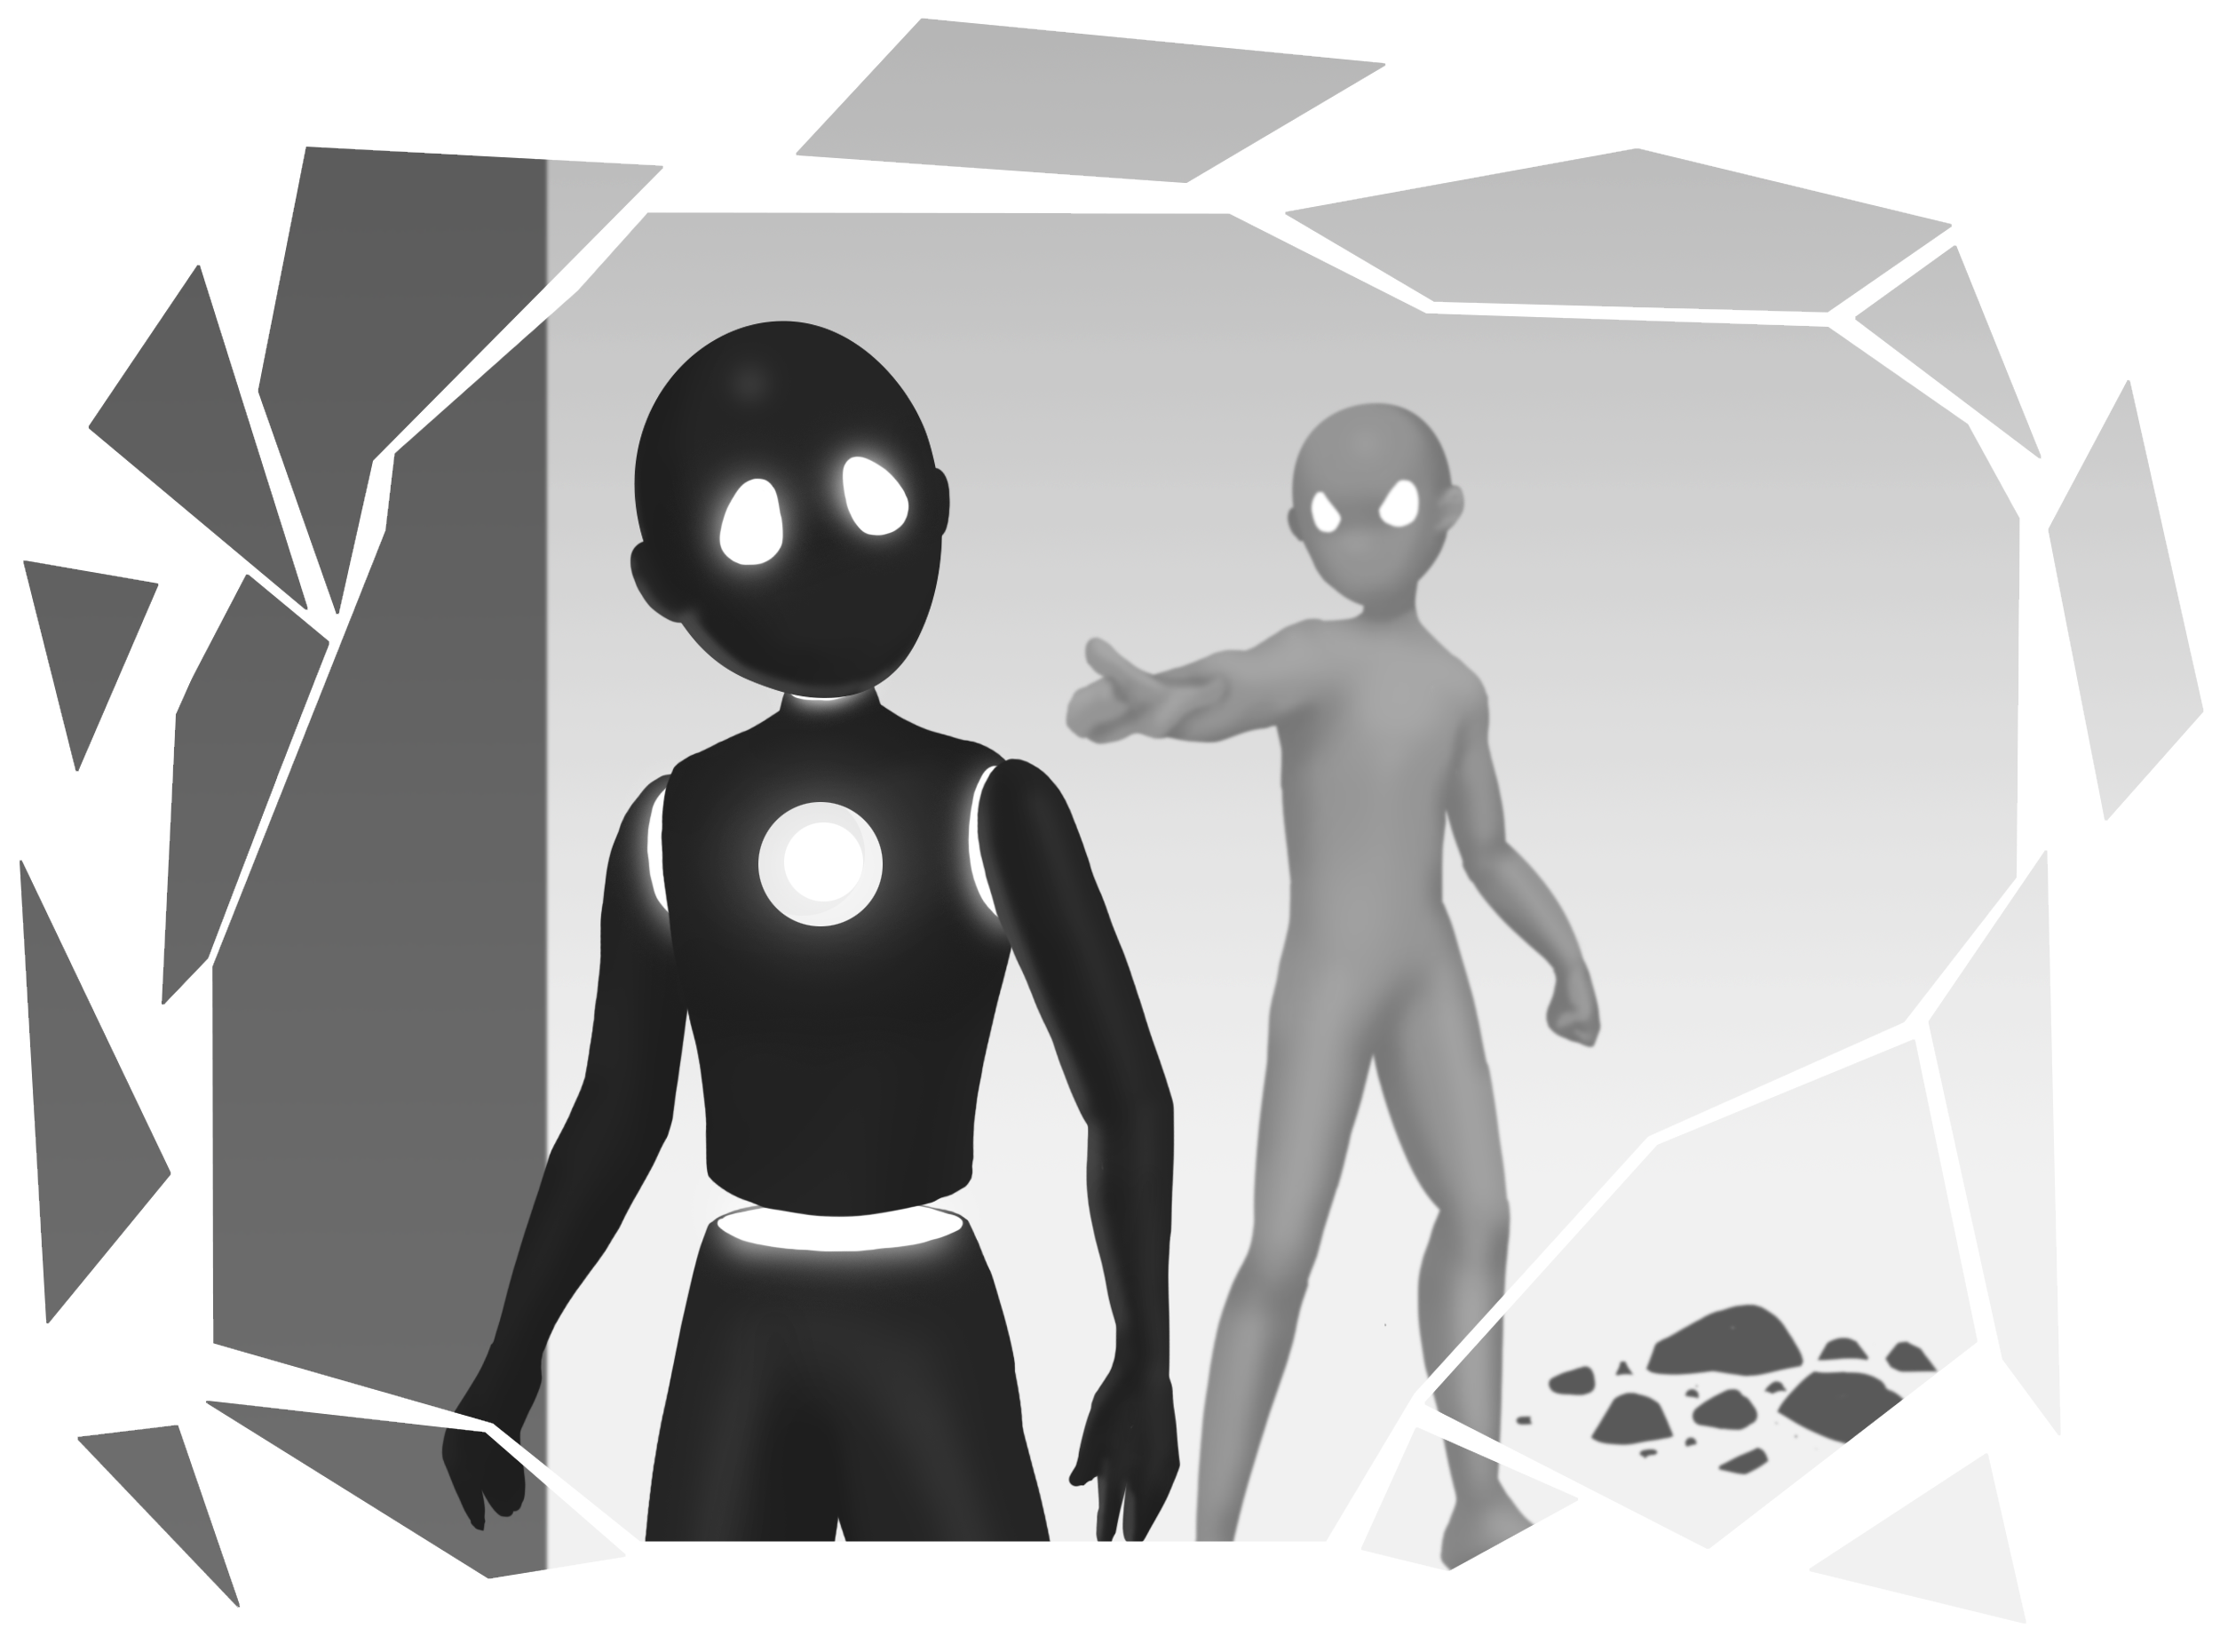

Slide 17

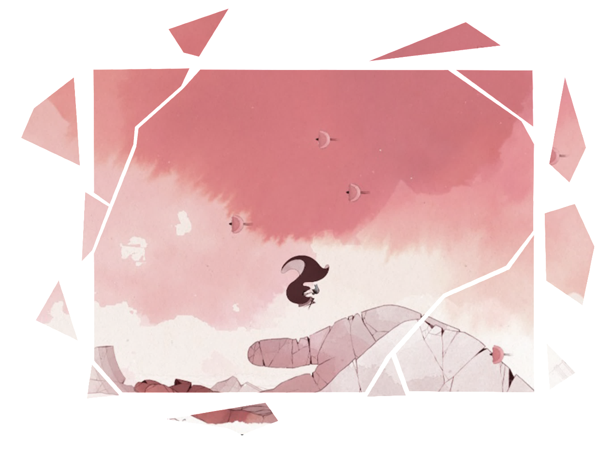
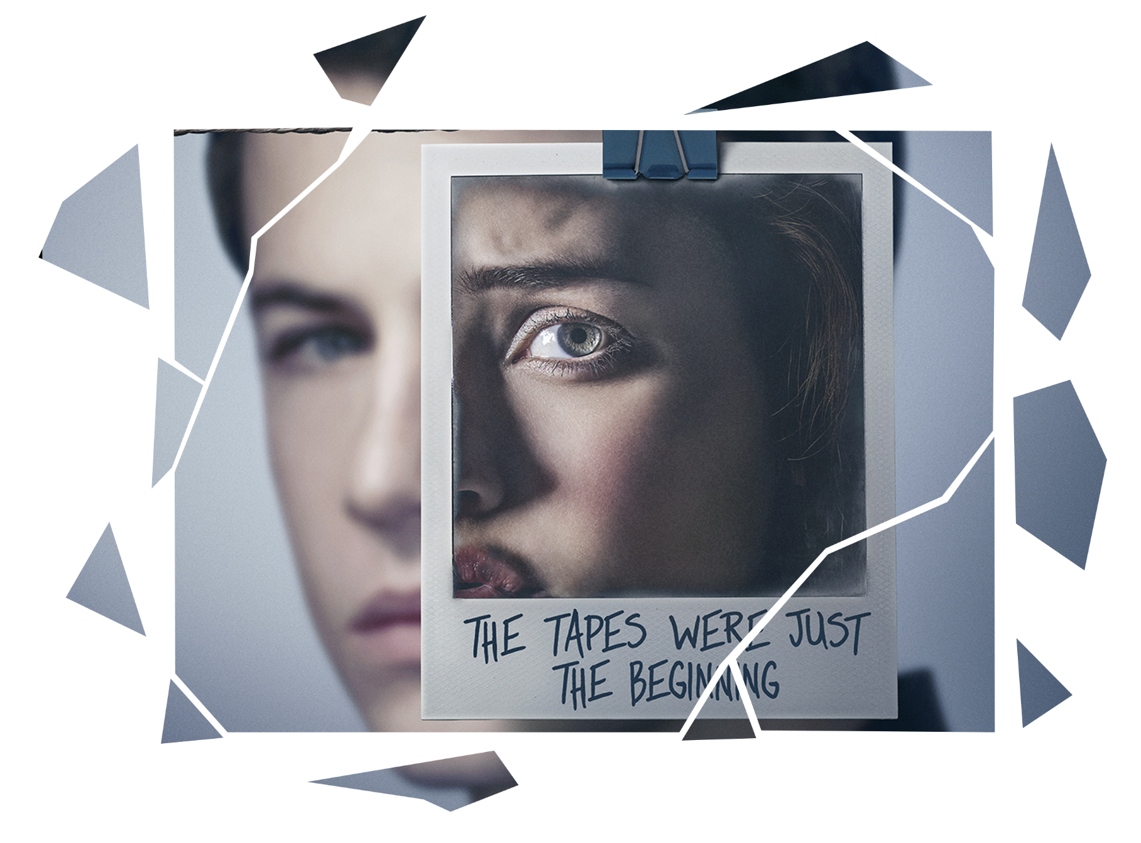
TRENDS IN MEDIA HISTORY
World of the mind
Mental health

Slide 18
UNIQUE SELLING POINTS
Character progression
Storytelling without text
Intertwined narrative and gameplay

Slide 19



TECHNICAL APPROACH

Slide 20
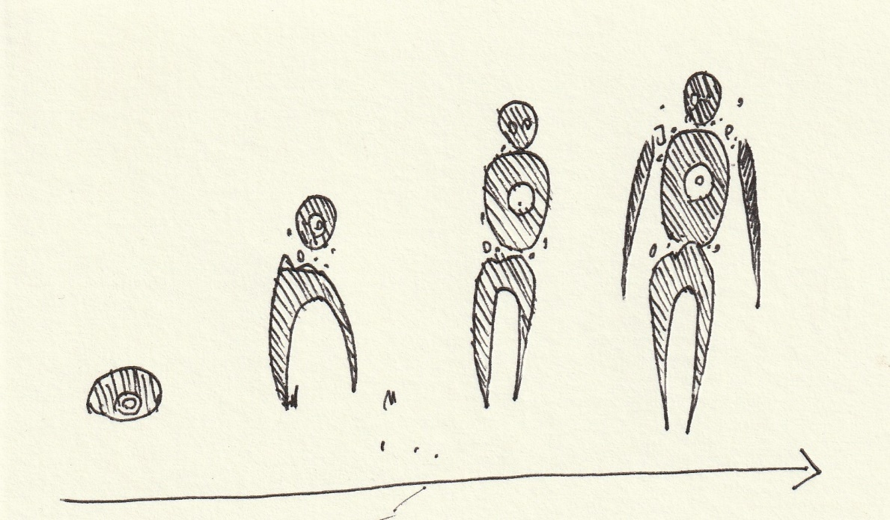
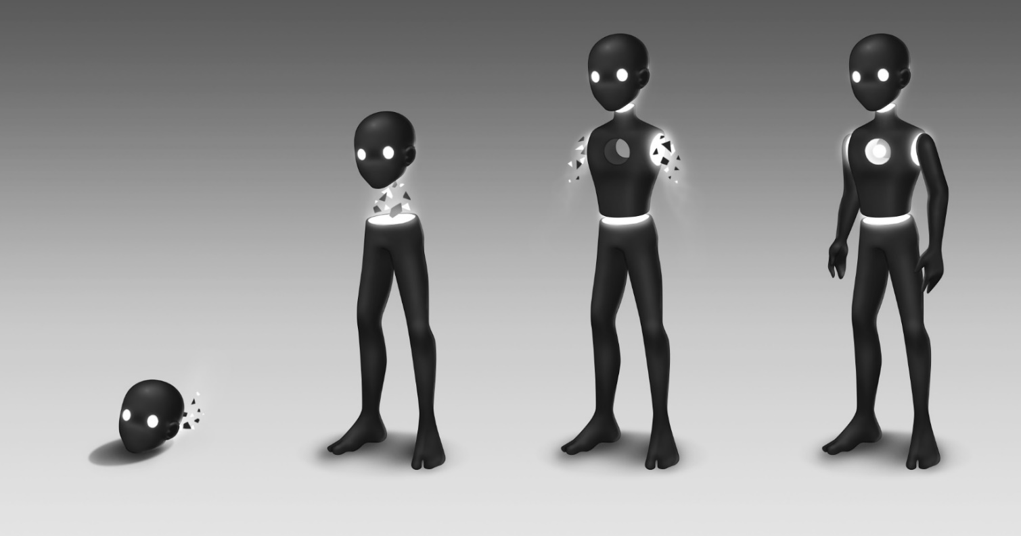
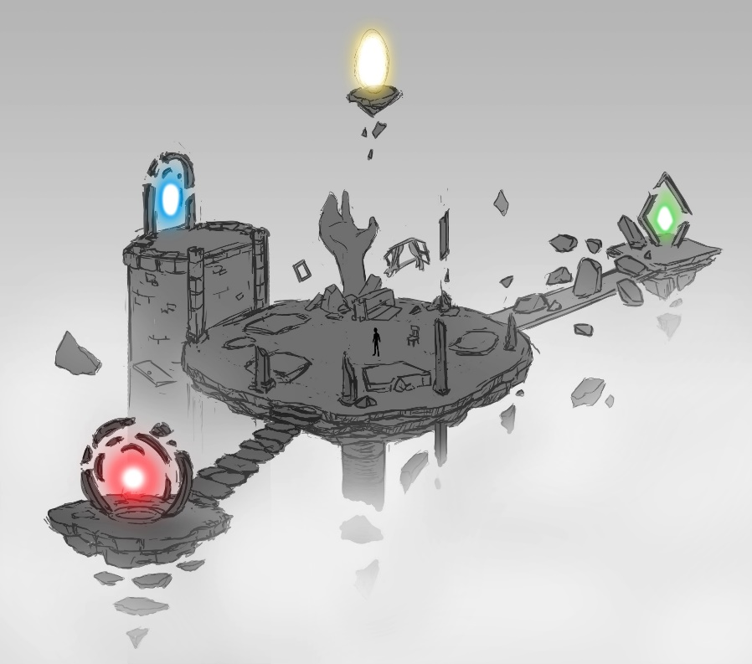
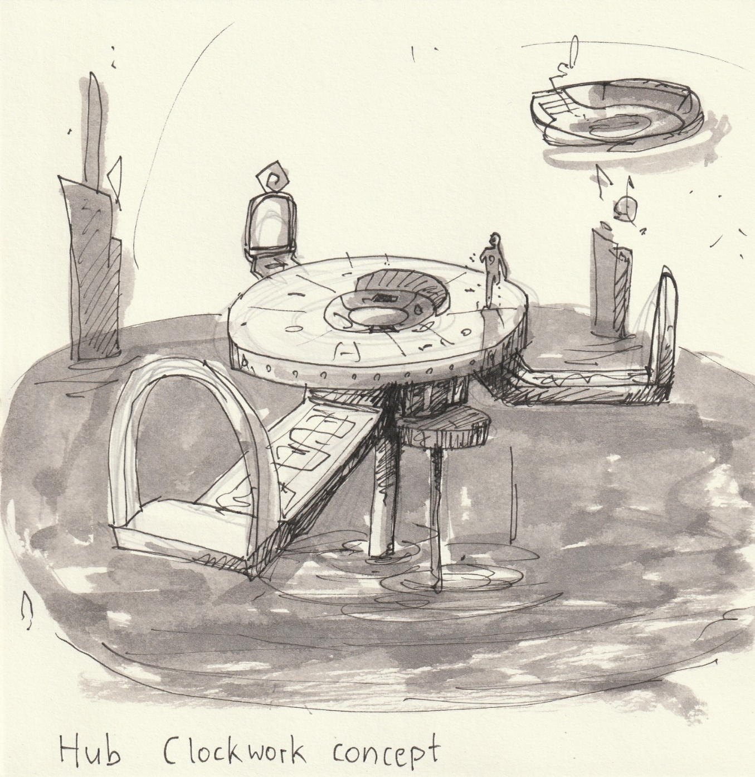
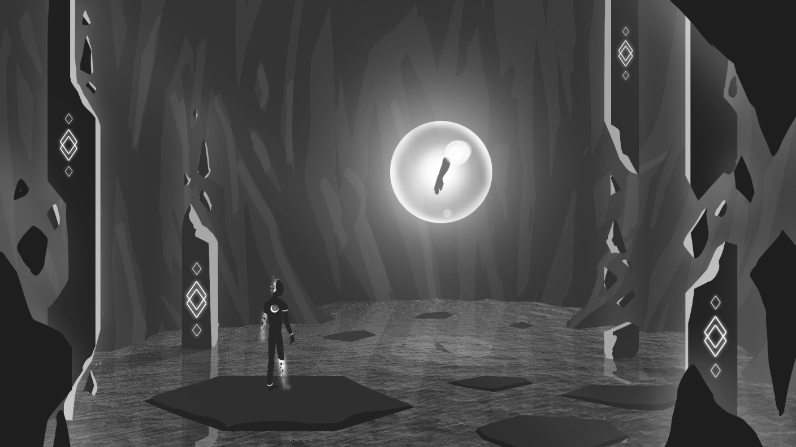
ART

Slide 21
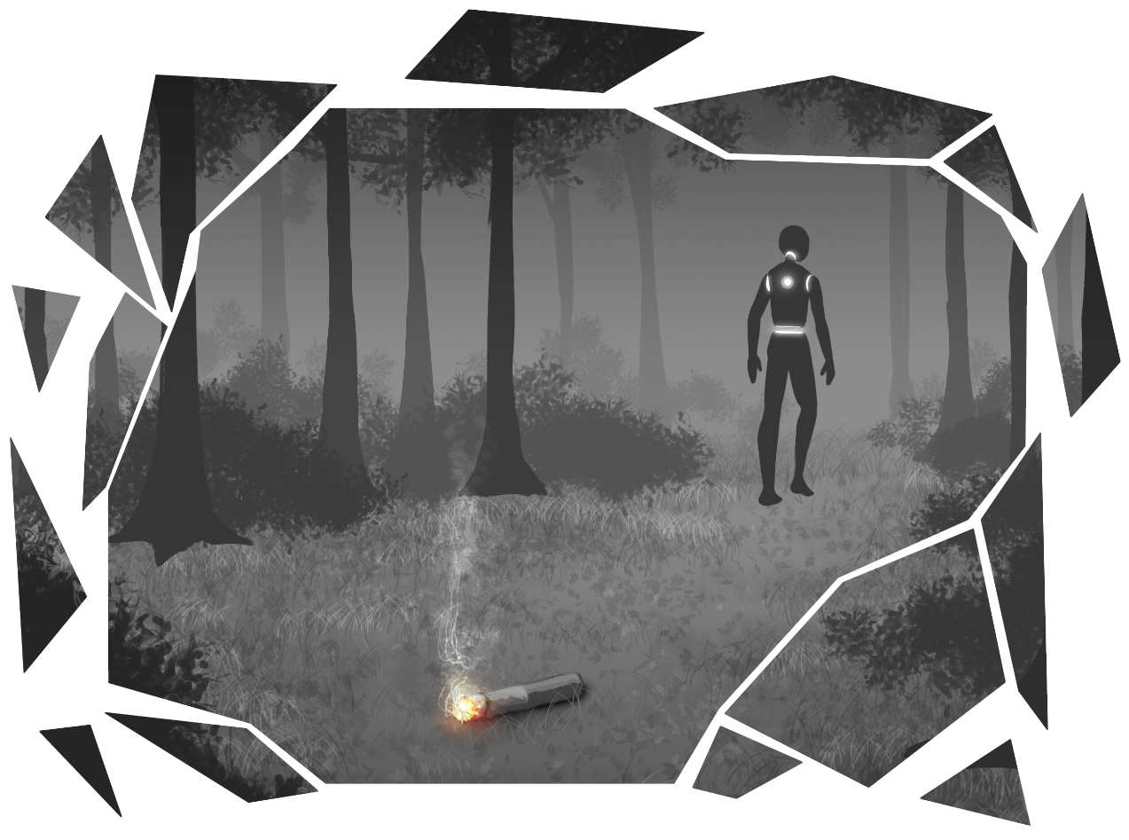

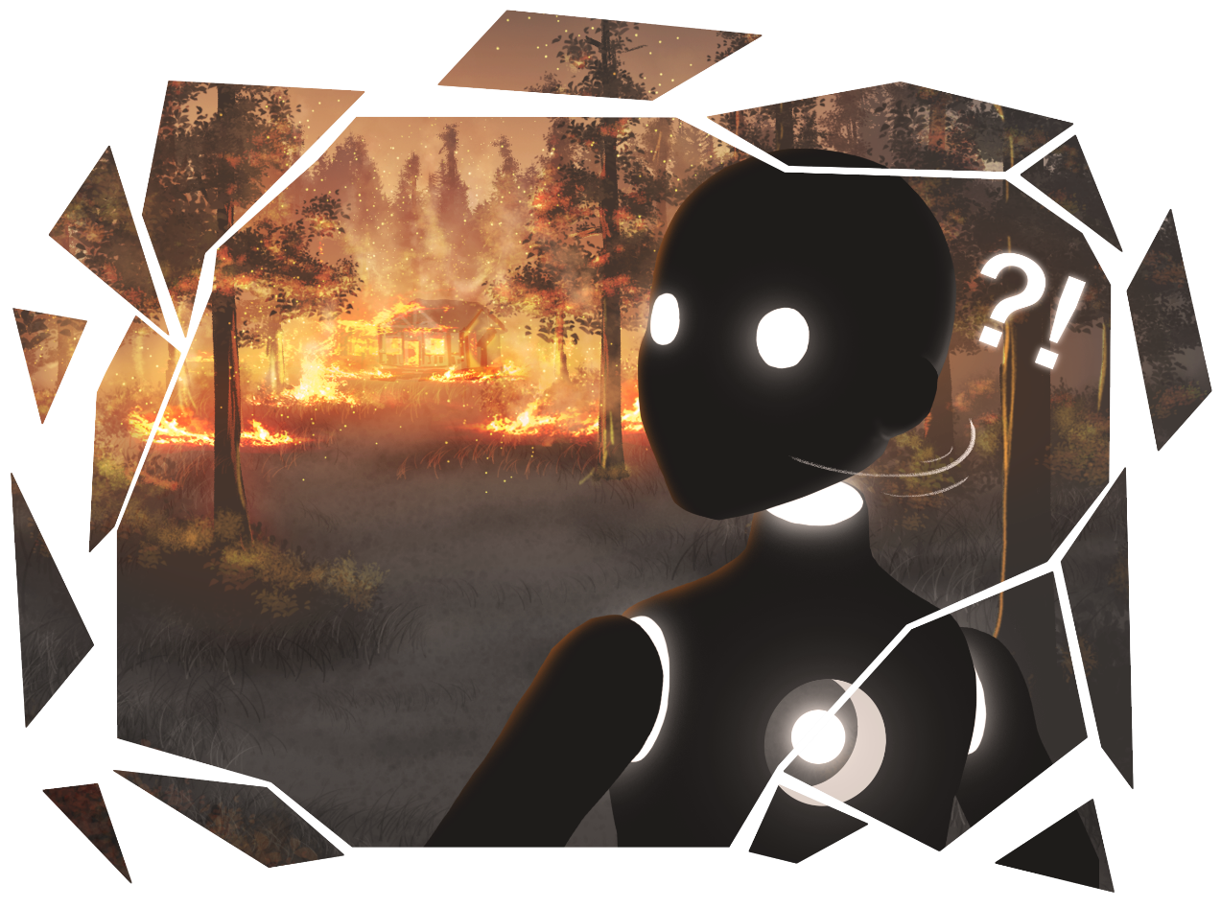
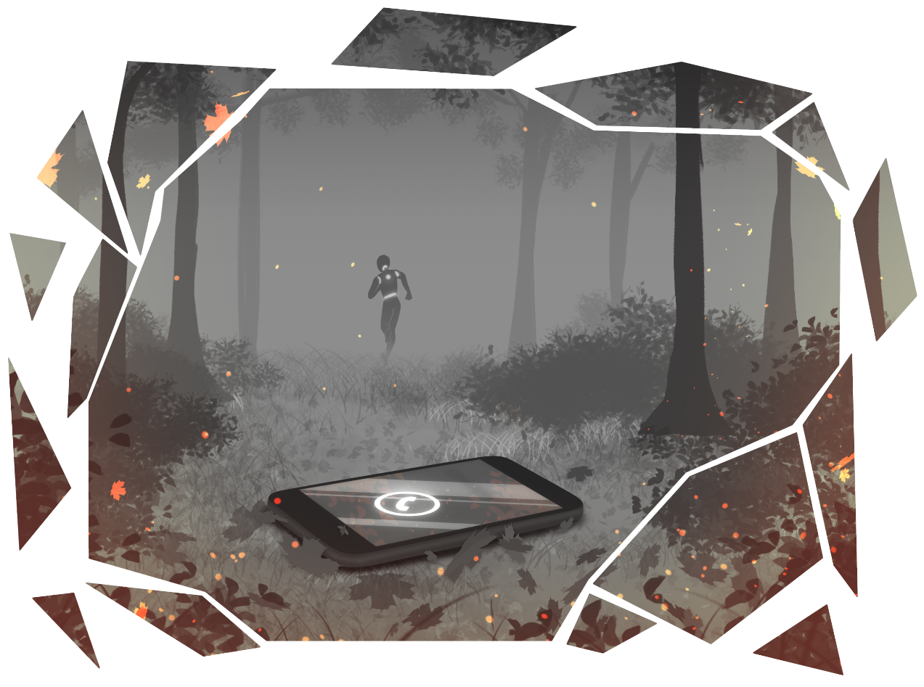

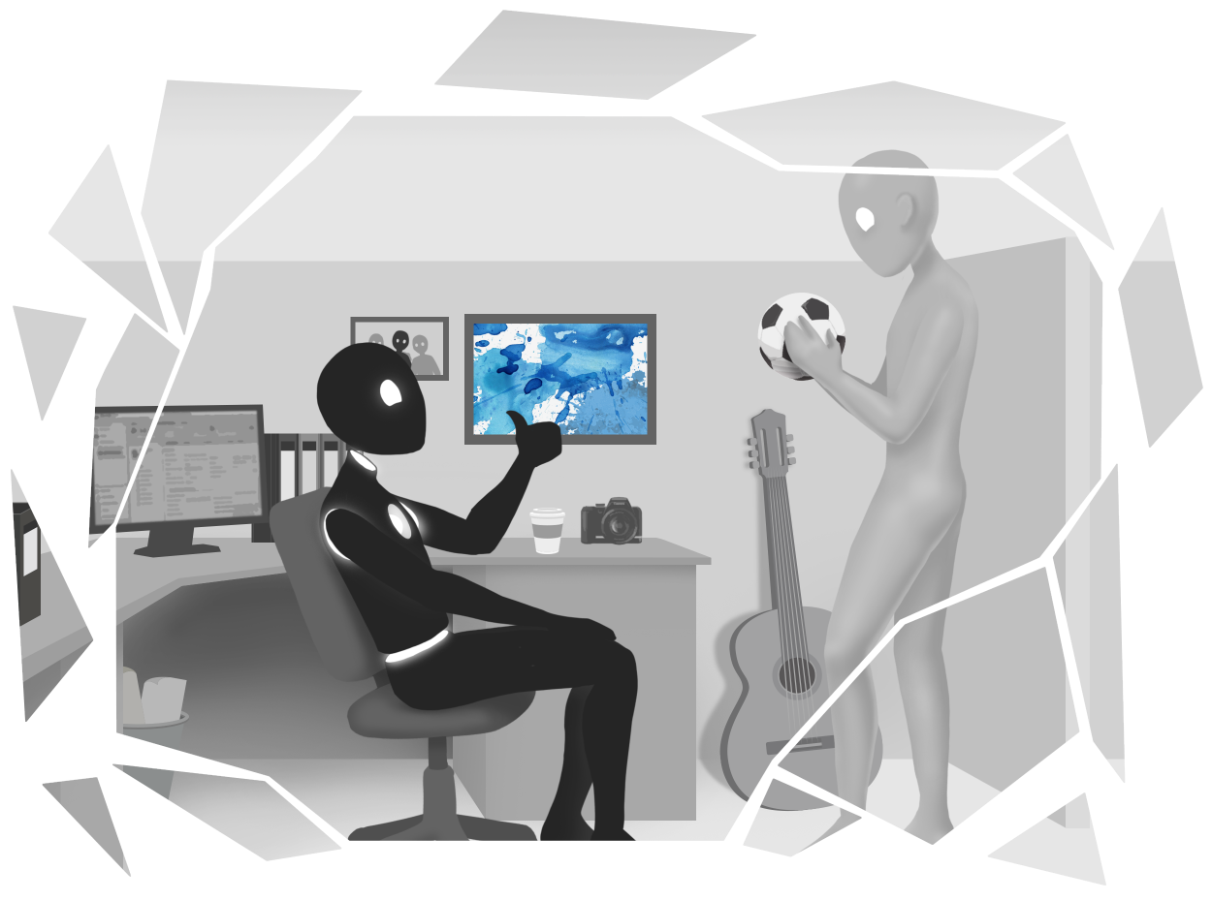

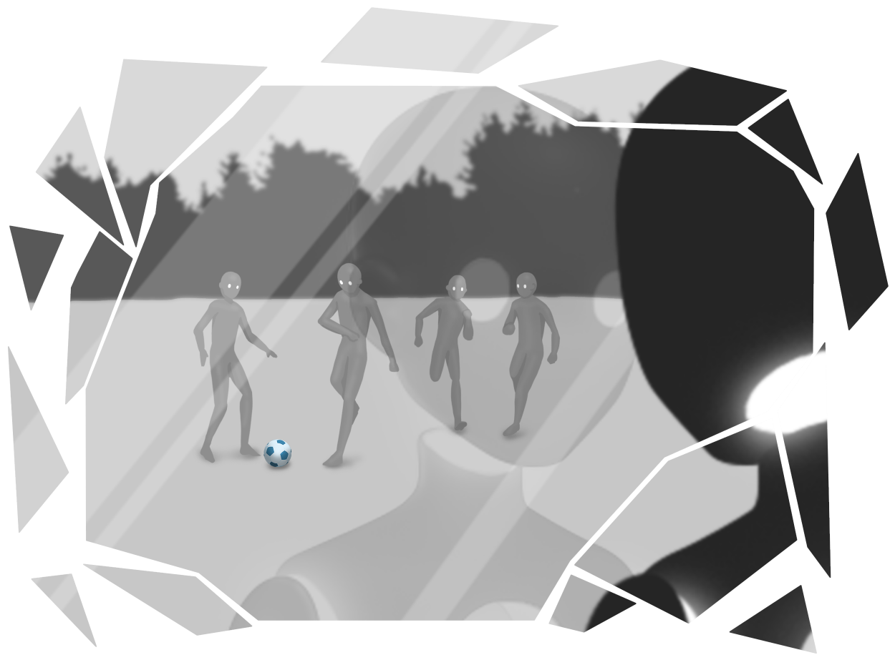

Slide 22
GAMEPLAY TRAILER

Slide 23



POST MORTEM
Team
Polish
Meetings
Playtesting
Hack’n’Plan
Project scope
Completed work
Wall run
Animation

Slide 24
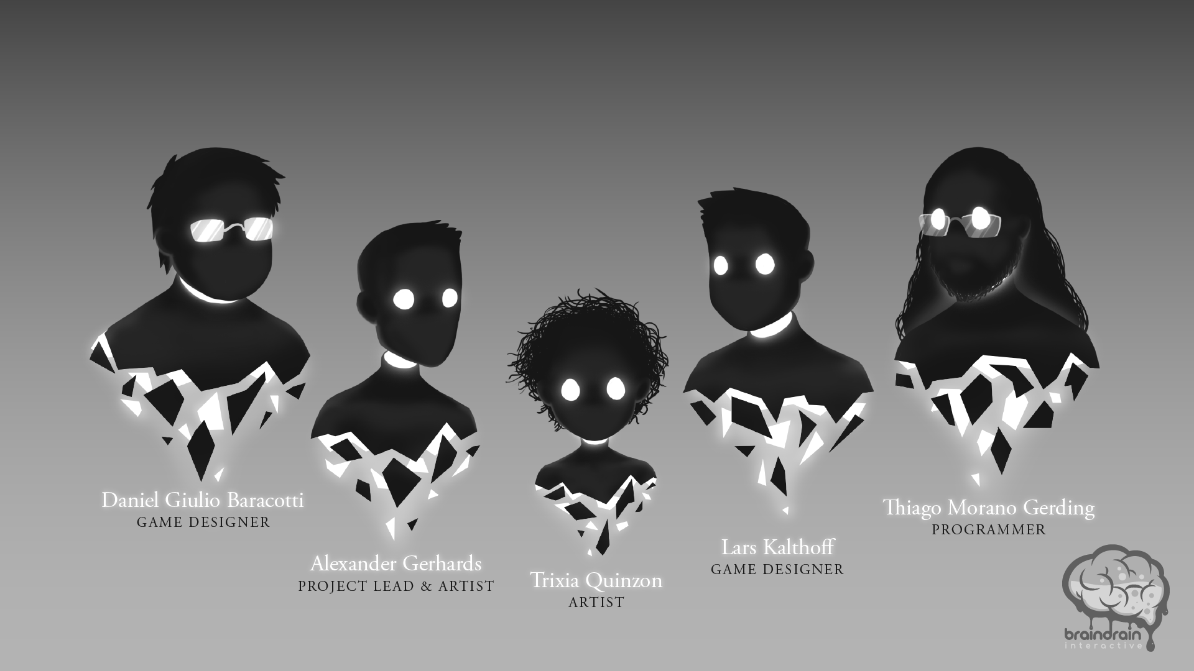
THANK YOU!

